Slide 1
10 Suggestions for Improving your Scientific Talks
Larry Fagan

Slide 2
Goals of this talk
1) Describe some small changes that will significantly improve BMI scientific talks (Larry)
2) Explain what steps you can take to actively learn while listening to a talk (Russ)

Slide 3
Why should you care?
[Giving talks]: Your great ideas won’t be communicated unless you can present clearly
[Listening to talks]: A key opportunity to develop your skills to synthesize information
Notes:
Essential skill no matter what career you take, no matter what you do --- you have to convince someone that your idea is worth supporting

Slide 4
1. Start from the beginning…
Don’t overload the title
Use the title slide to introduce and define your topic
Notes:
The talk starts at the beginning…introduce yourself,. Define terms in the title, provide the transition to the background and significance

Slide 5
2. Motivate the talk
What are the big ideas?
What does YOUR audience need to know?
Why should the audience sit through this talk? (from the medical/biological domain and computational perspective)?

Slide 6
3. Describe and analyze the prior work
Your research builds on previous work
You should briefly explain key prior projects
MOST IMPORTANTLY, you need to tell us:
  The limitations of the prior work
  How your research addresses those limitations

Slide 7
4. Explain the thesis
Improved computational method
OR
Existing method applied in new way
WILL HAVE a significant effect
on the ability to solve the scientific problem that you specified at the beginning…

Slide 8
5. Explain the method
Concentrate on one or two aspects of your research
Consider presenting the flow in both words and diagrams
Some parts should be understood by everyone, some parts may be understandable to only a few people in the audience

Slide 9
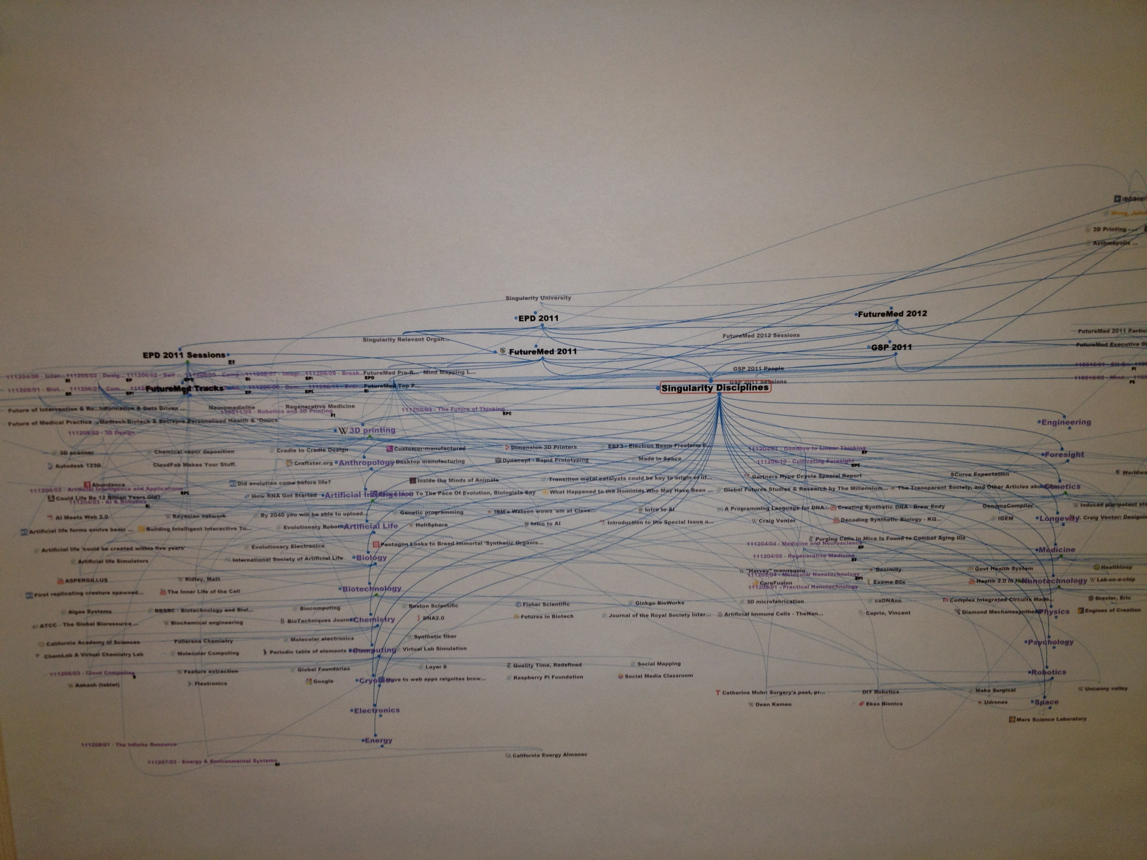
6. Make the diagrams readable
Notes:
Note: this is a negative example ☺

Slide 10
7. Don’t let presentation style keep you from communicating ideas
Face the audience
Speak slowly
Make sure you can be heard
Vary your spoken voice
Don’t read off of the screen
Use the pointer appropriately
Explain the axes of your graphs

Slide 11
8a. Limit the information on each slide
One of the biggest problems that I see (and I see it quite often) is that the speaker tries to put their whole talk onto the slide. And not just the most important information, but I mean the asides and things that really should be spoken and not listed word for word on the slide.
Another variant of this is when the speaker puts a set of words on the slide and then talks about a different topic, thus leaving the listener to try and read the slides and listen to the speaker at the same time. However, this is really very hard to do from a cognitive perspective.
Notes:
Another variant of this is when the speaker .. Is trying to make one point, but the words or diagram on the slides are making a slightly different point or giving the information in a different way. That is way worse than reading the slide.. from the cognitive perspective

Slide 12
8b. Limit the information on each slide
Keep to less than 50 words per slide
Use sentence fragments
Don’t show one set of text and talk about something different
Notes:
Now using the Ted talks style of presentation..

Slide 13
9. The talk should tell a logical story…
What problem are you solving?
Why should the audience care about it?
What have others done?
Why didn’t they solve the problem?
How will you address the problems in a different way?
How will you know that you have solved the problems in a superior way (or not)?

Slide 14
10. Summarize the takeaway messages
Provide the background and motivation for the audience
Communicate the scientific method in a series of logical steps (Hint: use the template)
Summarize how your approach will solve a clinical/biological problem using novel informatics approaches
Pay attention to presentation skills

Slide 15
Goals of this talk
1) Describe some small changes that will significantly improve BMI scientific talks (Larry)
2) Explain what steps you can take to actively learn while listening to a talk (Russ)

